Slide 1
Project based on Recommendation System
RECOMMEND BOOKS TO THE USERS

Slide 2

A Recommendation System is a subclass of information filtering systems that seeks to predict the preference a user might give to an item.
Business Objective
Generate the features from the dataset and use them to recommend the books accordingly to the users. The dataset comprises 3 files - books, ratings, users

Slide 3
Content
Data set details
Data preprocessing
Exploratory Data Analysis
Model Building
Model Evaluation
Deployment

Slide 4
Data sets -
Books -
ISBN - International Standard Book Number ; Books are identified by their respective ISBN
Book-title - Title of books
Book-Author - Author of books
Year-Of-Publication - Publication year of books
Publisher – Publisher of books
Image-URL-S,M,L - Books image links
Ratings-
User-Id - Unique Id for each user
ISBN - International Standard Book Number
Book-Rating - Rating of books given by users from 0 to 10
Users-
User-Id - Unique Id for each user
Location - location of users
Age - Age of users

Slide 5
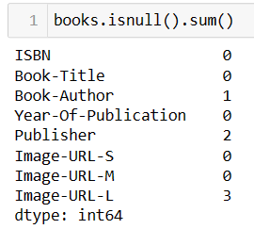

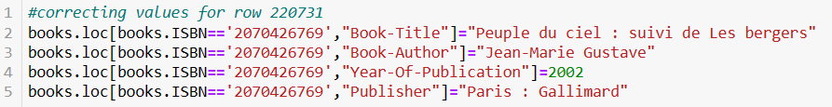

Data Cleaning
Books data set-
There are some null values in book author and publisher columns replacing those
null values with appropriate values
Wrong years are given in Year-Of-Publication column replacing all the insignificant values with appropriate values

Slide 6
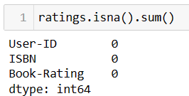

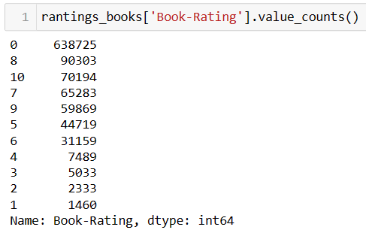
Ratings data set -
Null values are not present in rating data set
Value counts for each of the rating

Slide 7
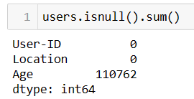
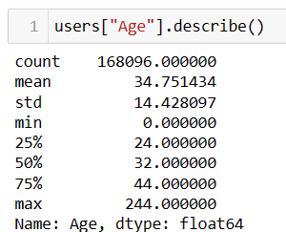
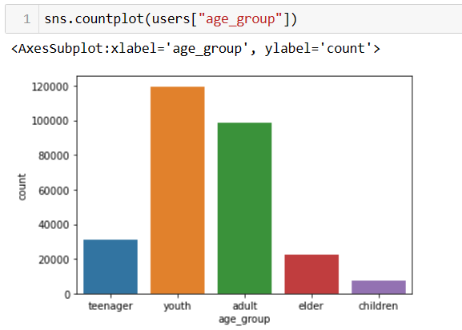
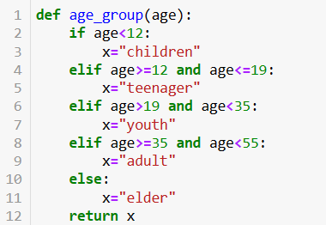
Users data set -
Age column contains huge number of null values
so replacing those values
Creating age groups for better understanding

Slide 8
Merging the dataset-
First merge books and ratings data set with the help of ISBN number
Combined books and rating data set merge with the users data set with the help of ‘User-ID’
Shape of this merged data set is – (377892,13)
Total number of unique users who have rated the books are 67063.
Total number of unique books in the merged dataset are 146930.

Slide 9
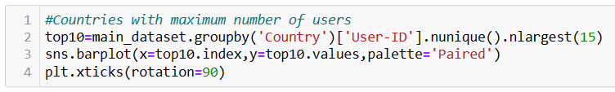
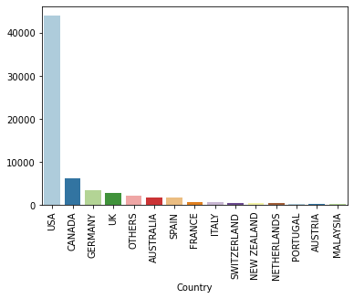
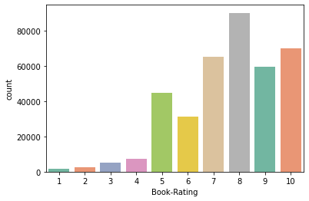
Exploratory Data Analysis
USA has maximum number of users among all countries
Maximum users given 8 rating to the books

Slide 10
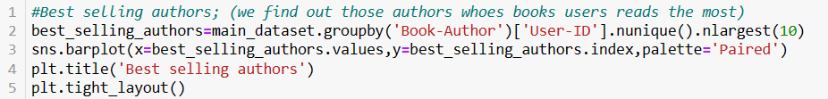
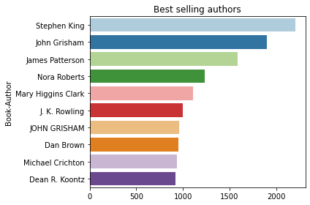
The best selling author is “Stephen King”

Slide 11
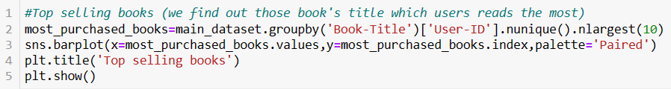
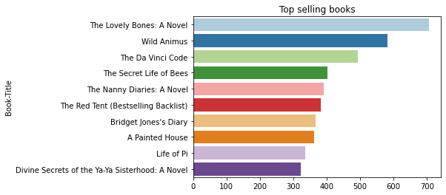
The best selling book is “The Lovely Bones : A Novel”

Slide 12
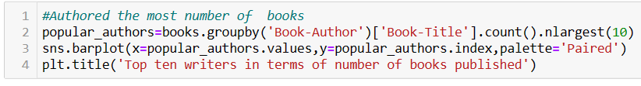
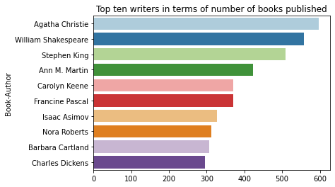
Agatha Christie authored the maximum number of books

Slide 13

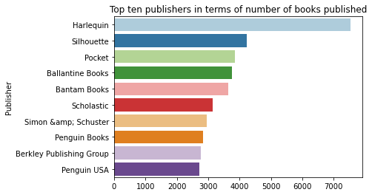
Harlequin published maximum number of books

Slide 14

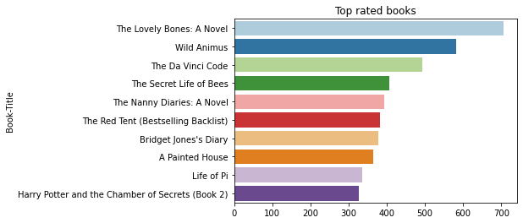
“The Lovely Bones : A Novel” is top rated book

Slide 15
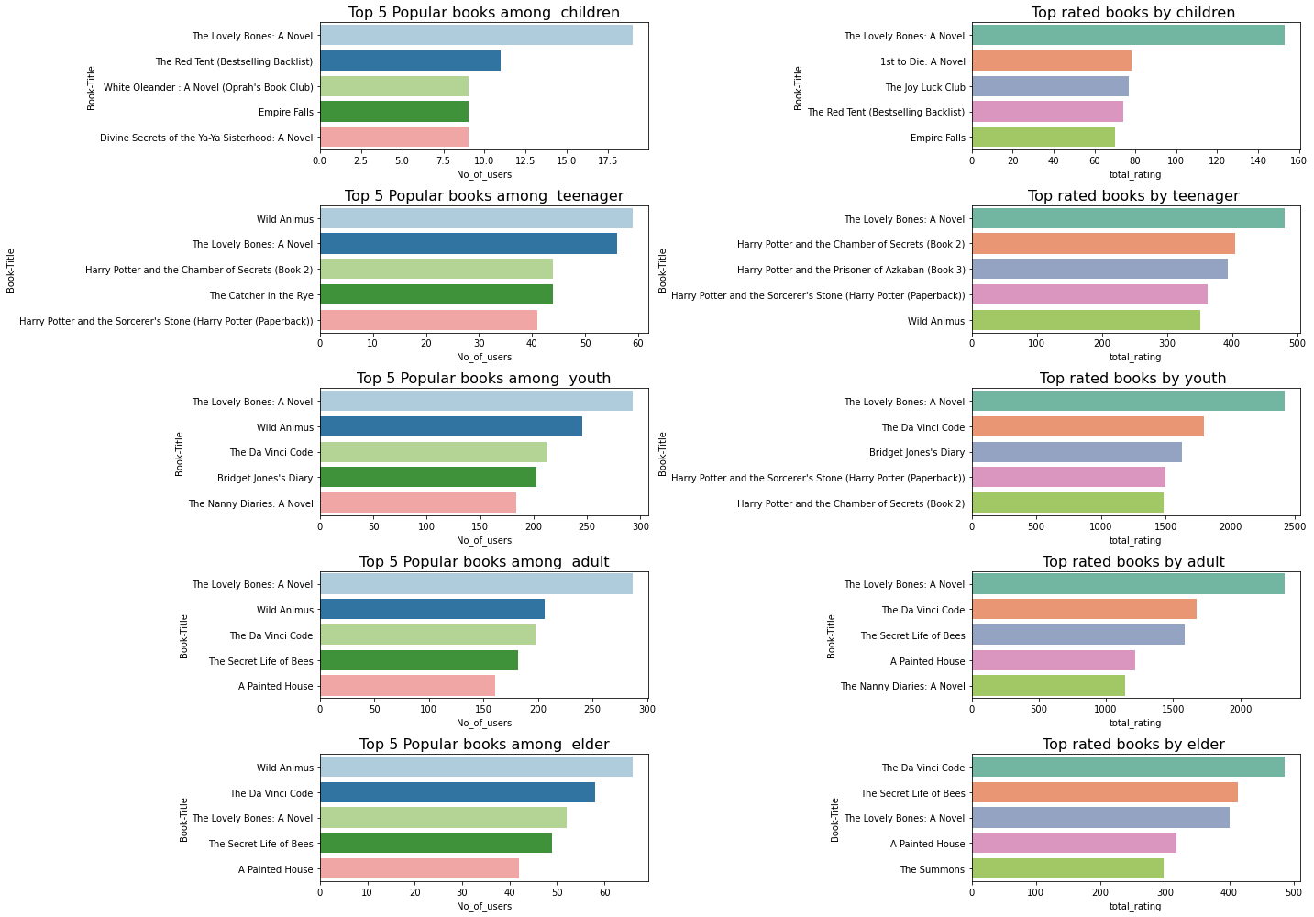
Top 5 popular books among children, teenager, youth, adult and elder.
Top 5 rated books among children, teenager, youth, adult and elder.

Slide 16
Conclusion based on EDA
Maximum users given 8 rating to the books.
Stephen King is the most popular Author.
The majority of the users who given the ratings are from USA
Agatha Christie is the writer who published maximum number of books.
Harlequin is the publisher who published maximum number of books.
‘The lovely bones: A Novel’ is most popular book.
Lovely bones: A Novel is also highly rated book by the users of all the age group.

Slide 17
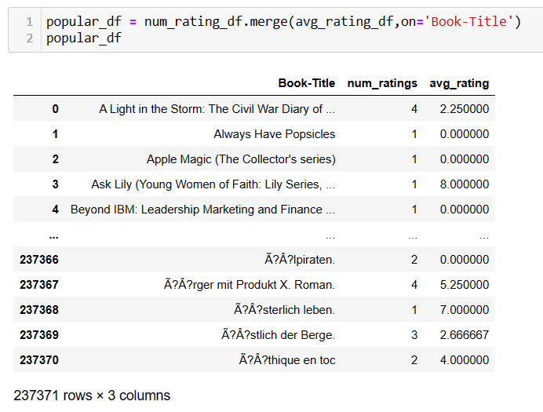
Recommendation System-Model Building
Popularity Based Recommendation System- Finding average rating and total number of ratings given to each book

Slide 18
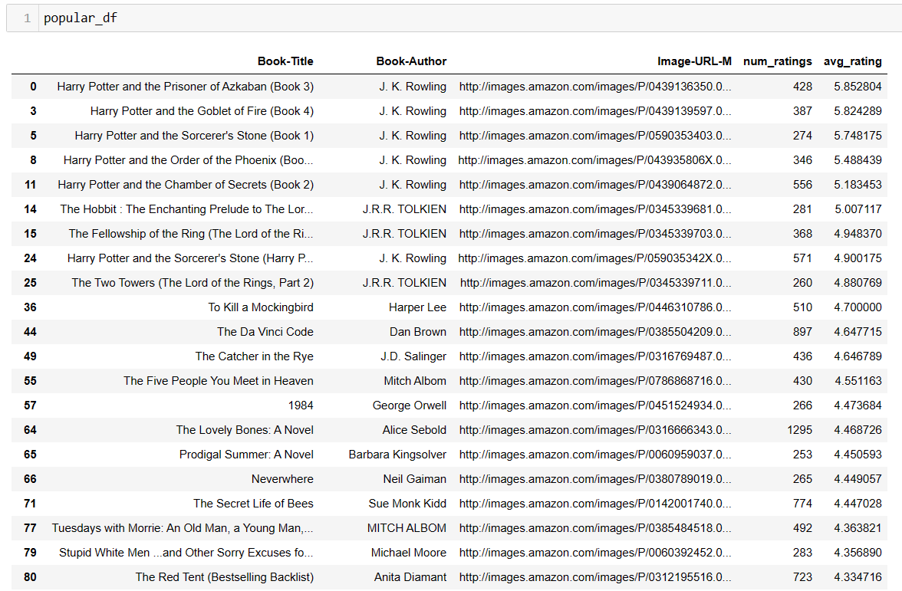
Top Most Popular Books

Slide 19




Top 4 popular books

Slide 20
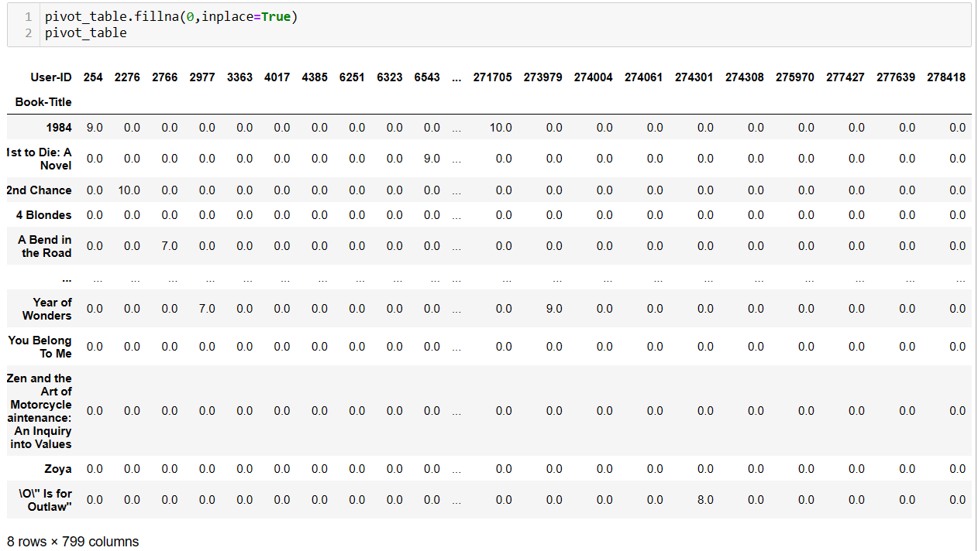
Collaborative Filtering Based recommendation system

Slide 21
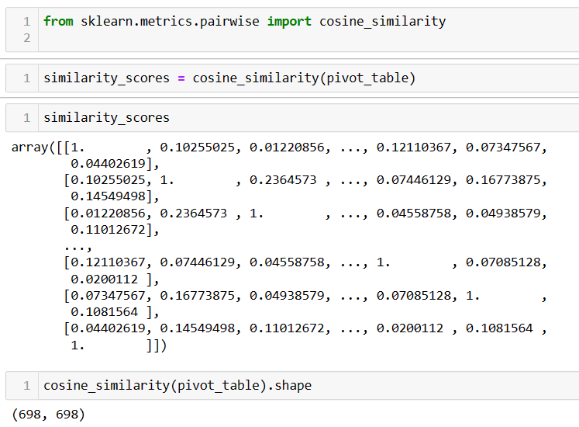
Cosine Similarity -

Slide 22
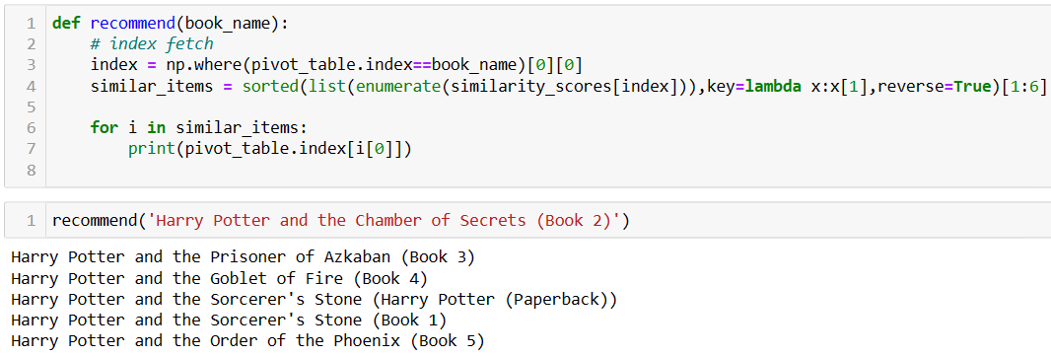
Model Evaluation

Slide 23





Book - The Da Vinci Code
Recommended books -

Slide 24
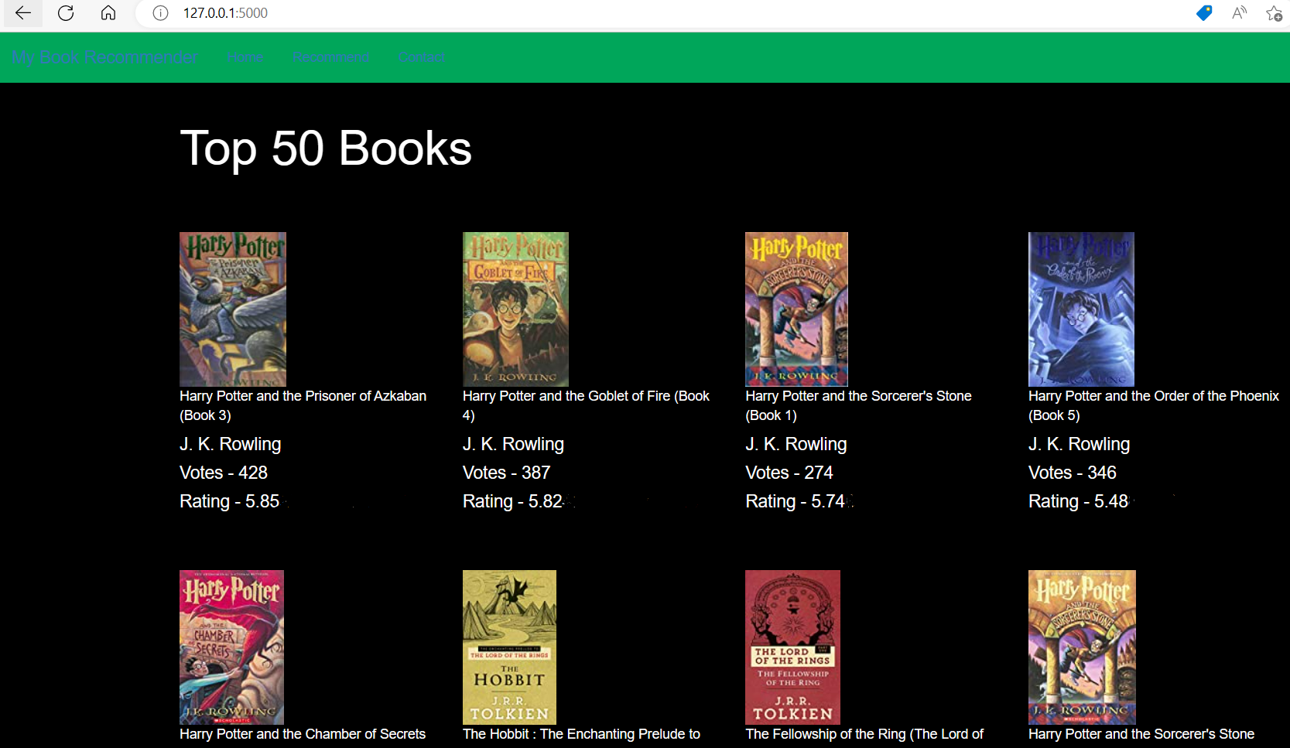
Deployment
Using flask for the deployment
In home tab top 50 books are shown with image of the books, name of the books, author of the books, votes(Total number of ratings), Ratings(average ratings)

Slide 25
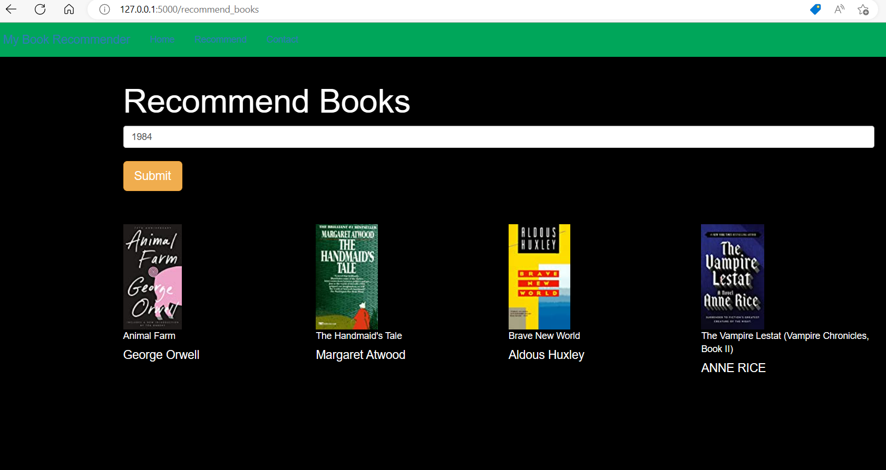
In recommend tab after submitting the book name deployment model recommends four books to users

Slide 26
Conclusion
The initial step of our project was Data preprocessing of the three datasets-books, users and ratings, wherein we removed duplicates and imputed the missing values & invalid entries with appropriate values and corrected spellings.
In EDA we understood majority of users are between the age of 19 to 35, majority of users given 8 rating, the top most author is Stephen king, top most publisher is harlequin and we get many more information by EDA.
Then, we used Popularity-based approach and Collaborative filtering approach to built recommendation models.
We build deployment model to recommend top 50 books as well as if user submit one book deployment model recommends 4 books accordingly.

Slide 27
Challenges
Data contains categorical as well as numerical data so data cleaning was a major concern.
Understanding the metric for evaluation was a challenge.
Decision making on missing value imputations and outlier treatment was quite challenging.
Handling of sparsity was a major challenge as well since the user interactions were not present for the majority of the books.
Synonymy arises an item is presented with two or more different names or entries having similar entries

Slide 28
Future Scope
Neural Networks and Deep Learning have been all the rage the last couple of years in many different fields, and it appears that they are also helpful for solving recommendation system problems.
We would like to explore various clustering approaches for clustering the users based on Age, Location etc., and then implement voting algorithms to recommend items to the user depending on the cluster into which it belongs.
Incorporating time into a recommender system is important, because there are often preference seasonal effects.

Slide 29
Thank You

